Slide 1

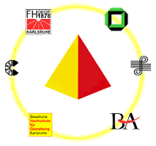
Making Courseware Reusable
Khaldoun Ateyeh, Jutta Mülle
Institute for Program Structures and Data Organization
Universität Karlsruhe
Germany
www.ipd.uni-karlsruhe.de/SCORE
www.vikar.de

Slide 2
Outline
Motivation: Why Courseware Reuse
Requirements
Our Approach
Atoms, Modules, Courses
Aspects
Module Types
Ontology
A Course Development Process
Summary

Slide 3
Motivation
The development of multimedia courseware
is a very difficult and costly process
is an interdisciplinary process
has high requirements on creativity
has to take psychological and ergonomical aspects into consideration
Why do we need to reuse Courseware?

Slide 4
Motivation: Current Situation
Current courseware tends towards a monolithic structure mixing content, structure, and presentation
Current courseware is difficult to:
  extend
  maintain
  update
  reuse

Slide 5
Outline
Motivation: Why Courseware Reuse
Requirements
Our Approach
Atoms, Modules, Courses
Aspects
Module Types
Ontology
A Course Development Process
Summary

Slide 6
Requirements: Courseware
Modular courseware
Adaptable courseware
  Adaptability to different university types
  Adaptability to students
  Adaptability to educators
  Adaptability to learning form
Support for cooperation
Support for open standards
Effective search and discovery mechanisms

Slide 7
Outline
Motivation: Why Courseware Reuse
Requirements
Our Approach
Atoms, Modules, Courses
Aspects
Module Types
Ontology
A Course Development Process
Summary

Slide 8
Our Approach
To meet our goals our approach proposes to:
Divide courseware into self-contained learning modules
Separate different aspects such as content, structure, and presentation
Use Standardized Metadata
Create community and domain specific ontology

Slide 9
Our Approach: Atoms, Modules & Course
The basic building blocks of our solution are learning atoms
Each learning atom contains a specific learning unit, say a definition, an example, a proof
Learning atoms that deal with a semantically closed set of contents form learning modules
a course is composed of modules and deals with a specific context

Slide 10
Our Approach: Aspects
Which aspects should be adaptable?
Content
Structure
Presentation

Slide 11
Our Approach: Module Types
Thus, technically a learning module has three variations:
Content
Structure
Presentation
Integration
Module
Structural
Module
Presentational
Module
Notes:
+

Slide 12
Our Approach
Learning Subject
Learning Module
Learning Module
Learning Module
cooperation + content
Group of authors
Integration Module
choice, structure, didactics
Views of single authors
Structural module
Structural module
Structural module
Presentational module
presentation
Presentational module
Presentational module
Presentational module
Distance learning view
Print view
Face-to-face view
Print view

Slide 13
Our Approach: Metadata
Metadata is used to describe the various aspects of a learning object
Metadata Standards “Learning Object Metadata LOM”

Slide 14
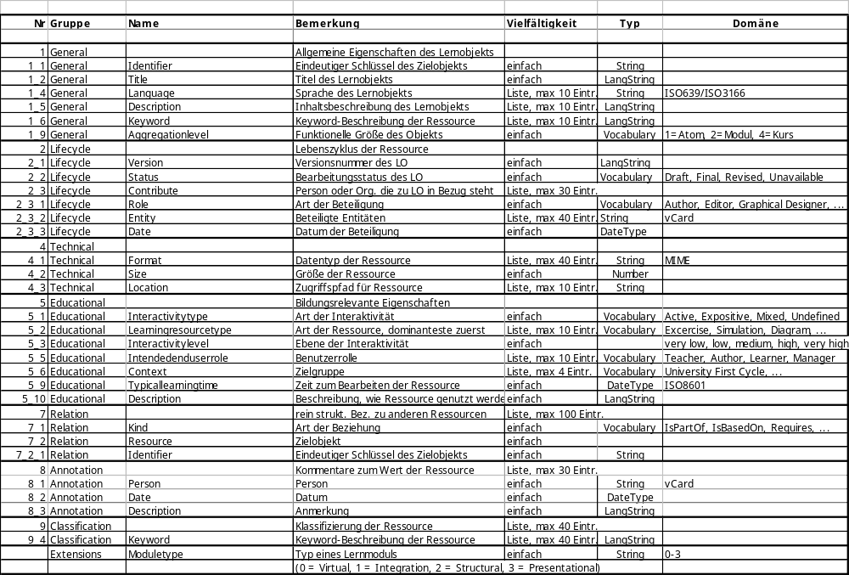
SCORE-Metadata-Standard
General characteristic of the Learning Object
Lifecycle of the Learning Object
Technical Aspects of the Learning Object
Educational Aspects
Structural Relationships to other Learning Objects
Annotation Information
Content Relationship to other Learning Objects in the Ontology
Type of a learning Module

Slide 15
Our Approach: Ontology
A set of concept definitions and their relationships
A common basis for cooperation and exchange within one community
A browsing space

Slide 16
Outline
Motivation: Why Courseware Reuse
Goal of SCORE
Our Approach
Atoms, Modules, Courses
Aspects
Module Types
Ontology
A Course Development Process
Summary

Slide 17
Course Development: CourseBuilder
Define a course structure
The course structure defines at this stage
a first outline or a concept of the course
It includes the separation of the course into
modules and a specification of each module
This step could also be conducted later
(after the “search modules“ step)
Define a course
structure
Search modules
Assemble course
Release course
Existing
modules
Suitable
modules
Course with
metadata
Ontology Browser
Module Builder
Metadata Editor
Export
Structuring Tool
Search
Presentation Generator
Uploader

Slide 18
Course Development: CourseBuilder
Search modules
for every specified module search a suitable
module in module repositories
the search could be conducted in form of
queries or browsing an ontology space for
the subject
Define a course
structure
Search modules
Assemble course
Release course
Existing
modules
Suitable
modules
Course with
metadata
Ontology Browser
Module Builder
Metadata Editor
Export
Structuring Tool
Search
Presentation Generator
Uploader

Slide 19
Course Development: CourseBuilder
Assemble course
adapt found modules to specific needs
develop unavailable modules
connect modules by adding course specific
(context specific) materials
add and extract metadata for the course
generate a presentation for the course
Define a course
structure
Search modules
Assemble course
Release course
Existing
modules
Suitable
modules
Course with
metadata
Ontology Browser
Module Builder
Metadata Editor
Export
Structuring Tool
Search
Presentation Generator
Uploader
ModuleBuilder
This tool is used to deal with all aspects of
a module

Slide 20
Course Development: CourseBuilder
Release course
upload and publish course
export course
Define a course
structure
Search modules
Assemble course
Release course
Existing
modules
Suitable
modules
Course with
metadata
Ontology Browser
Module Builder
Metadata Editor
Export
Structuring Tool
Search
Presentation Generator
Uploader

Slide 21
Outline
Motivation: Why Courseware Reuse
Goal of SCORE
Our Approach
Atoms, Modules, Courses
Aspects
Module Types
Ontology
A Course Development Process
Summary

Slide 22
Summary (1)
Basic Problem:
  Courseware development is extremely costly and time consuming
Desirable:
  Reusable courseware, i.e. create courseware in a way that allows to use parts of it in other contexts, for other audiences and by other educators
  this is prevented by monolithic courses
    that do not separate contents from structure and presentation
    do not identify semantic units of teaching

Slide 23
Summary (2)
Our approach:
  divide contents into smallest semantic units
  combine related units to form modules
  separate different aspects, in particular: contents, structure, presentation
  metadata standards and ontology
  provide tools to help
    devise a course structure
    find existing materials that cover the topics needed
    structure contents according to individual needs
    adapt material to presentation requirements.

Slide 24
Thank you!
Thank you for your attention!
Additional information can be found at
http://www.ipd.uni-karlsruhe.de/SCORE

